Slide 1



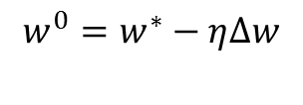
Node 1
Backpropagation
OpenMP/CUDA for BLAS
Node 0: Host ( )
SGD, Adam, AdaGrad or Hessian-Free
Node 2
Node 3
……
Node 6
Node 7

